Slide 1
Airline Overbooking Simulation Model
Avinash Bisram
BUA 631 Project 2

Slide 2
Problem Statement
Southeast Airlines is considering starting to “overbook” certain flights in the new year. “Overbooking” refers to when an airline sells more tickets for a given flight than that flight has maximum capacity for. This is done under the assumption that some passengers that purchase tickets, will inevitably miss their flight due to various reasons (known as “no-shows”) and leaving their seats vacant. To maximize the efficiency and potential profit of every flight, airlines use overbooking to fill each flight as much as possible. However, if more ticket-holding passengers arrive to a flight than can be seated, the airline is forced to conduct “involuntary denied boardings”, and those passengers are entitled to compensation equivalent to 200% of their original ticket cost. Southeast Airlines wants to find the optimal number of tickets to sell for a flight with a given average ticket cost and capacity, to maximize overall profit. Furthermore, the expected percentage of “no-shows” varies between 0% and 5% and can be modelled by a discrete probability distribution (based on historical analysis).

Slide 3
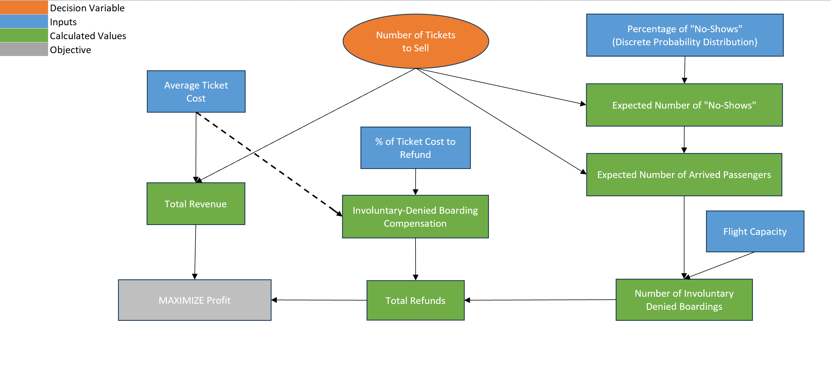
Big Picture Diagram

Slide 4
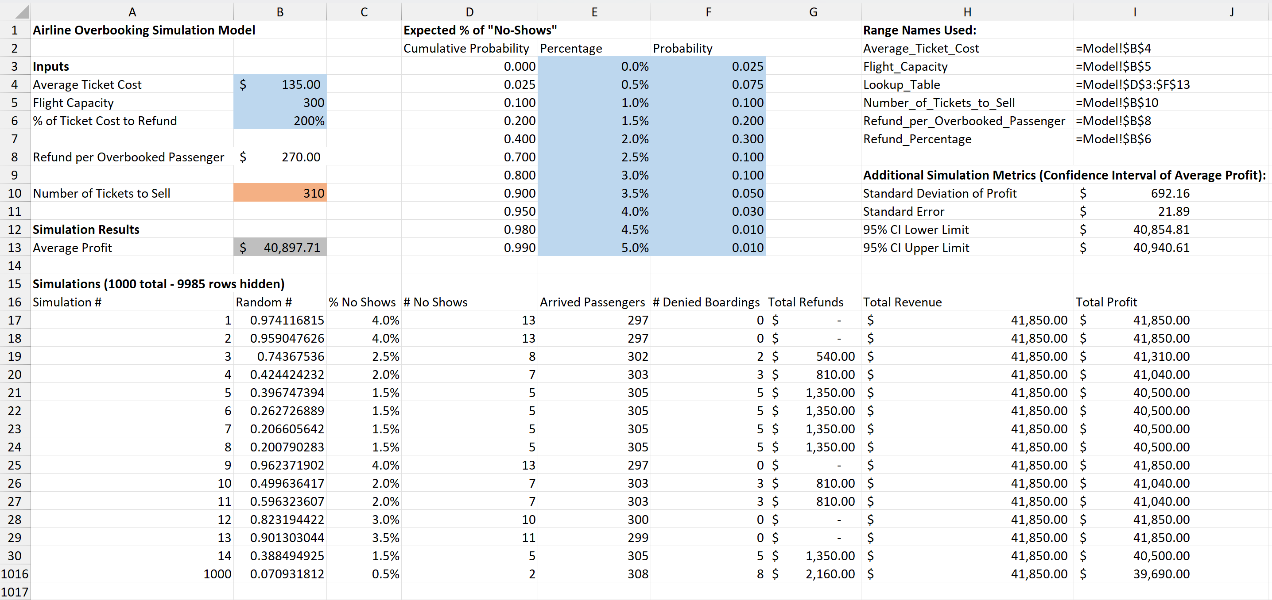
Spreadsheet Model

Slide 5
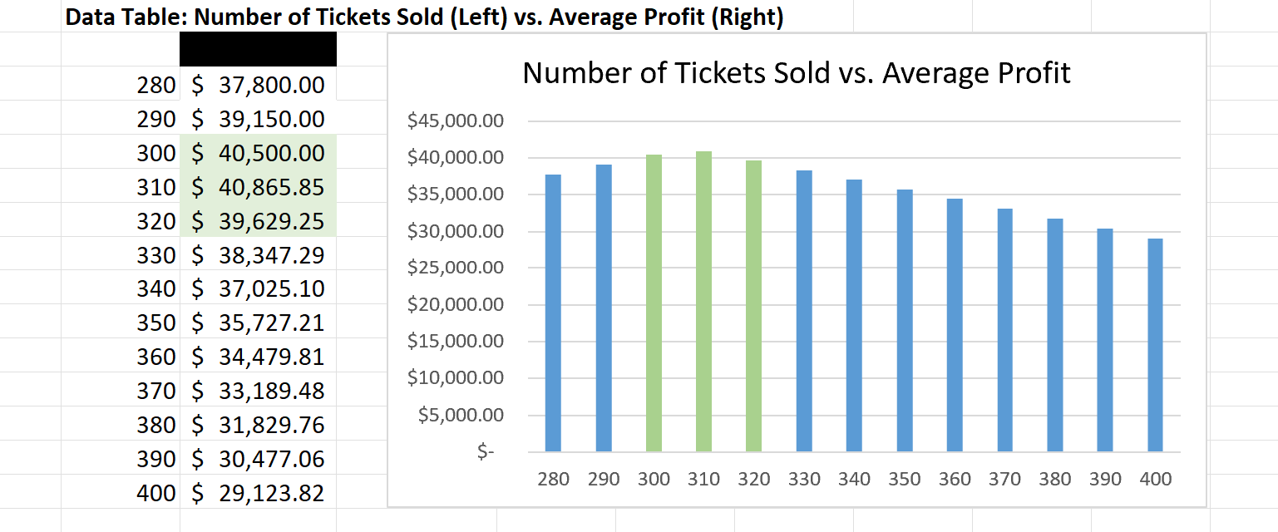
Optimal Decision Value

Slide 6
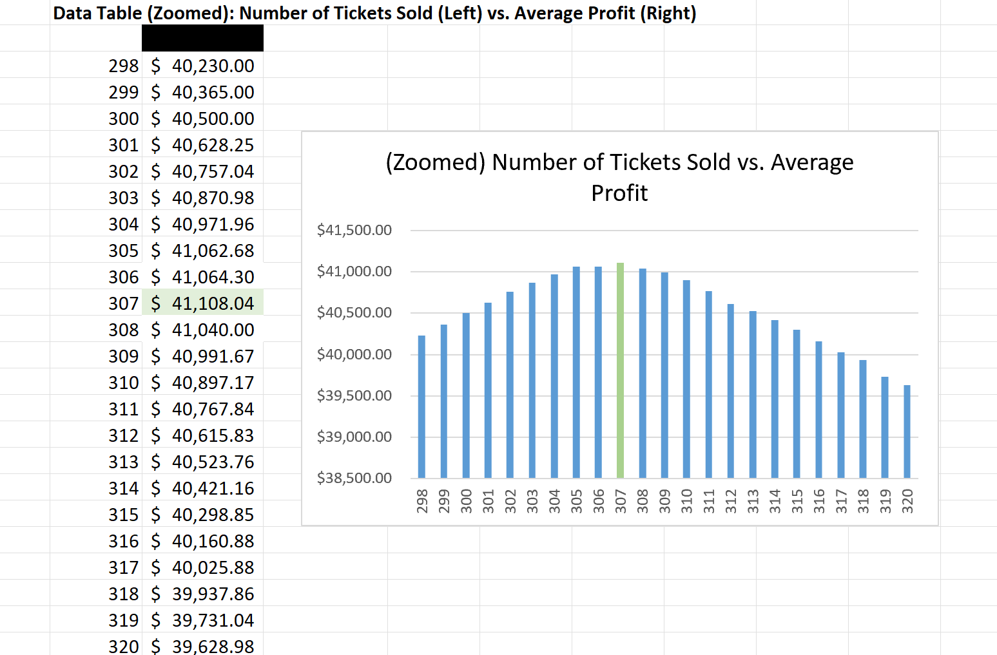
Optimal Decision Value (Continued)

Slide 7
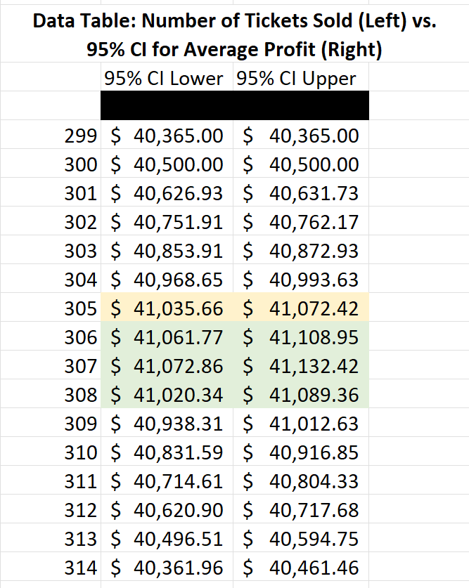
Additional Insights (Confidence Intervals)

Slide 8
Key Takeaways
After performing 1000 simulations, the optimal number of tickets to sell (given the inputs of average ticket cost, flight capacity, and expected % of no shows) is 307 tickets resulting in an average profit of $41,108.04 (95% CI: $41,073 , $41,132).
However, at a 95% confidence level, selling 307 tickets is not significantly more profitable compared to selling 306 or 308 tickets.
Furthermore, since the confidence interval of average profit when selling 307 tickets was greater than that of selling 300 tickets (with no overlap), we can conclude that there is a significant difference between the two decision values and in this scenario, overbooking is beneficial to the airline in maximizing profit.

